Slide 1
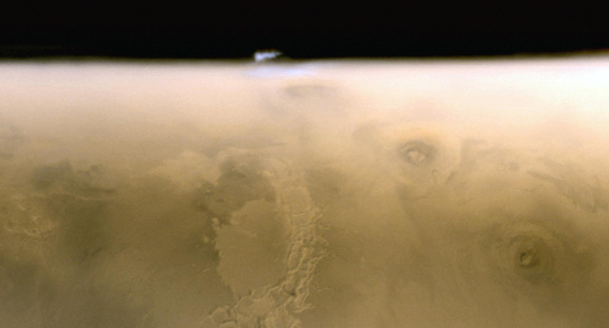

Citizen Science:
Opening Pathways to Discovery through the Cloud
National Aeronautics and
Space Administration
Jet Propulsion Laboratory
California Institute of Technology
Pasadena, California
Michelle Viotti, Manager, NASA Mars Public Engagement Program
Gov 2.0, May 26, 2010

Slide 2
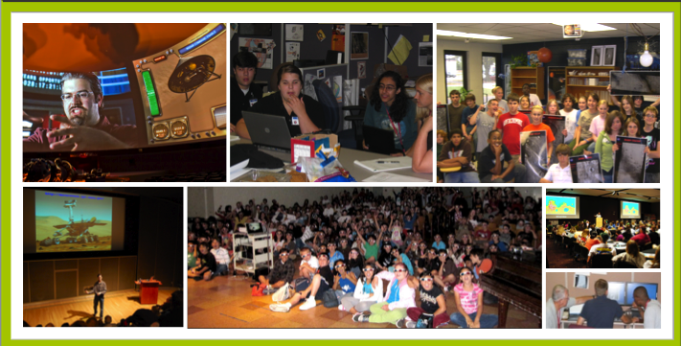
Open Gov Contributes to National Goal:
STEM Literacy
Not just access to data, but experience using data—building critical digital-age skills necessary for a 21st Century economy

Slide 3
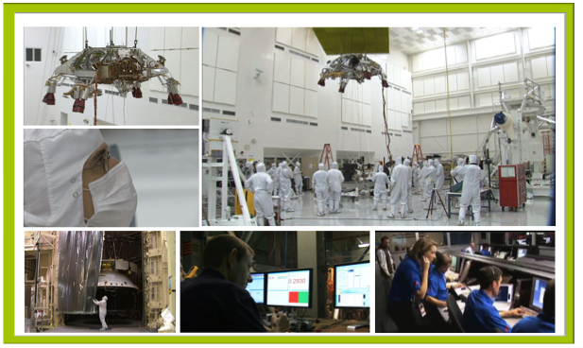
Open Gov Contributes to National Goal:
Encouraging STEM Careers

Slide 4
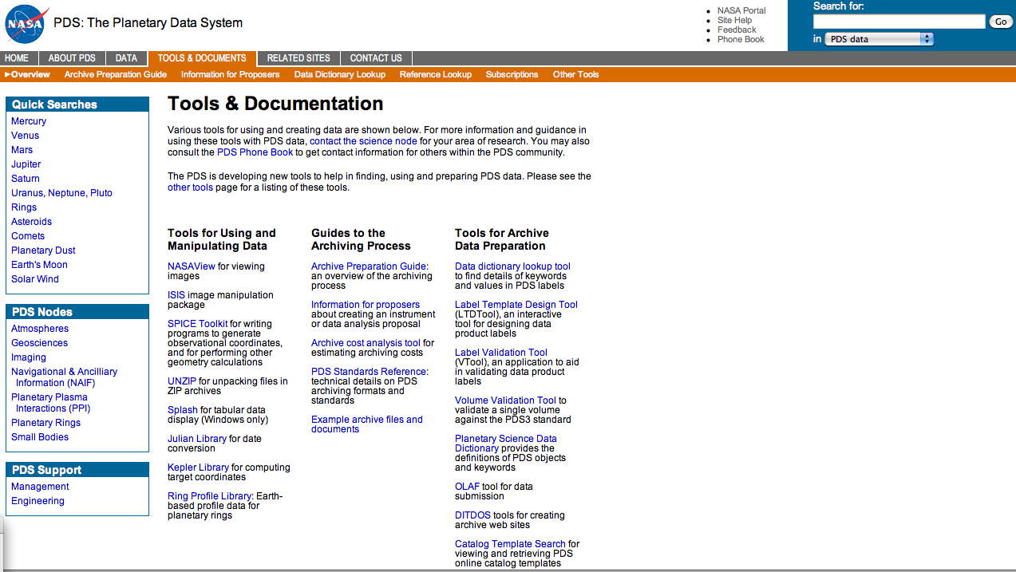
Accessible Data - ?
Yes, but….
Planetary Data System: a fantastic public archive of data from NASA planetary missions, designed largely for researchers

Slide 5
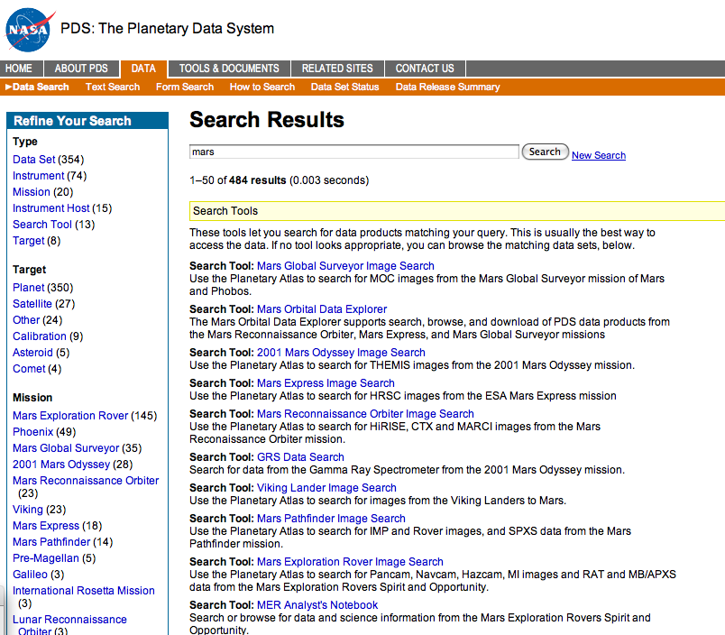
Simple Search: Mars
Results: Much data available

Slide 6
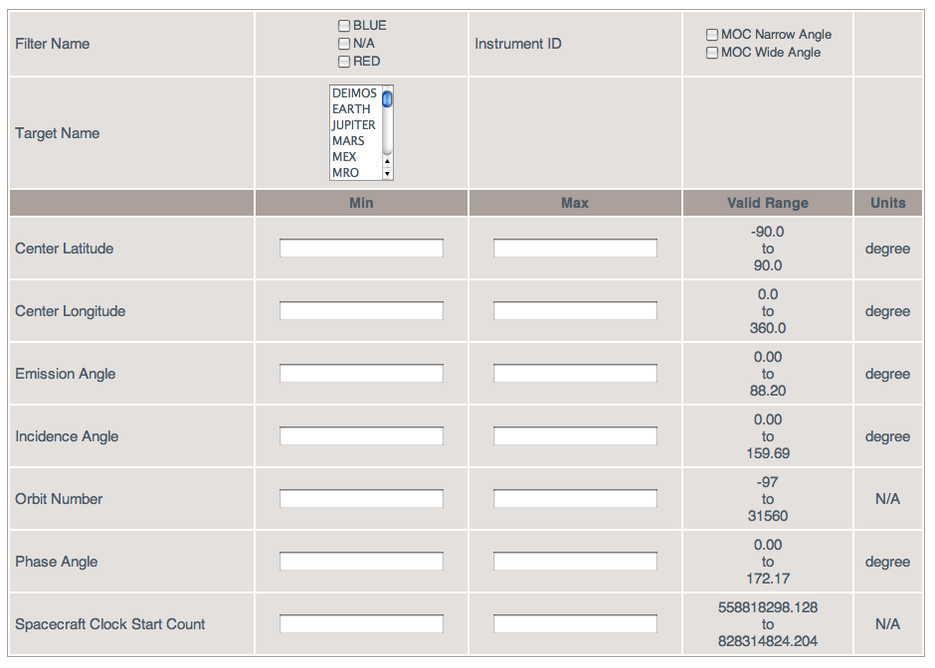
One of the Many Tools for Accessing Mars Data
Works great for knowledgeable experts

Slide 7
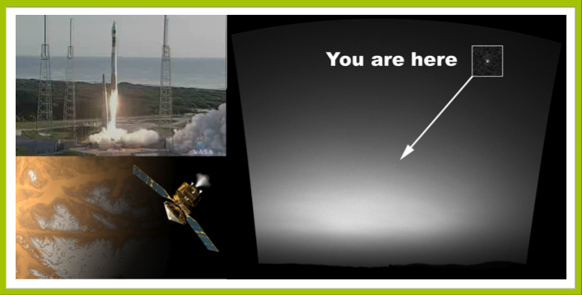
“It’s a Civilization Endeavor”
Philosophy that Mars Exploration belongs to all of us—not just for “rocket scientists”

Slide 8
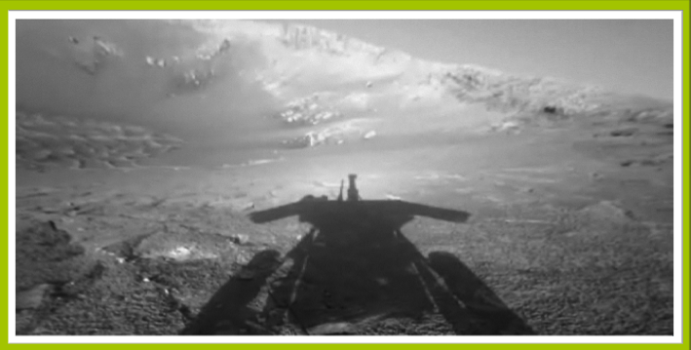
Human-Robotic Partnership:
Extending Our Presence Beyond Our Home World

Slide 9
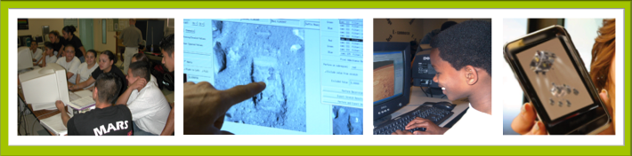
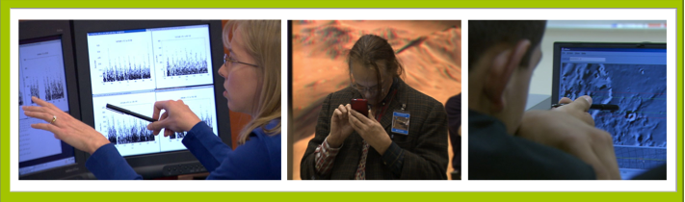
Citizens want to engage
More than a decade of authentic opportunities for K-14 students, now expanding through virtual teams and social networking

Slide 10
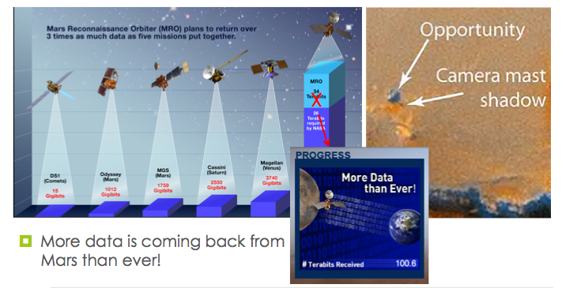
Citizen Science is Desired!
Small science teams, no matter how talented, can use crowd-sourcing for useful surveys and analysis

Slide 11
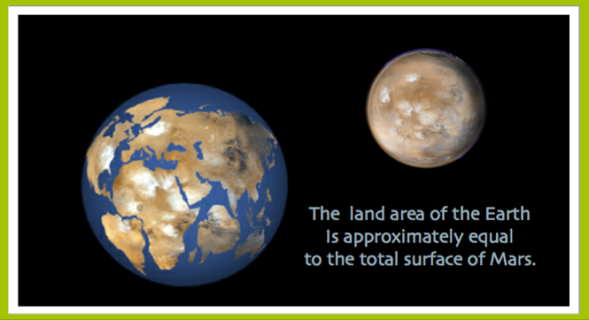
Opportunities Abound for Citizen Science

Slide 12
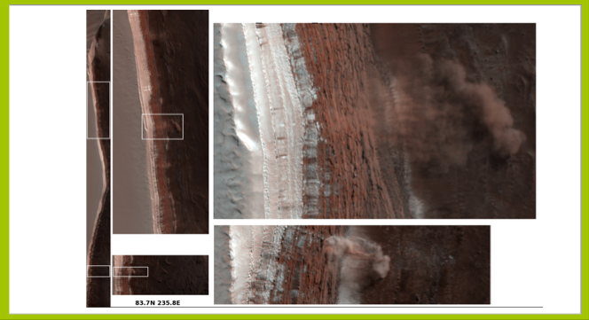
Surface Changes: Avalanches!

Slide 13
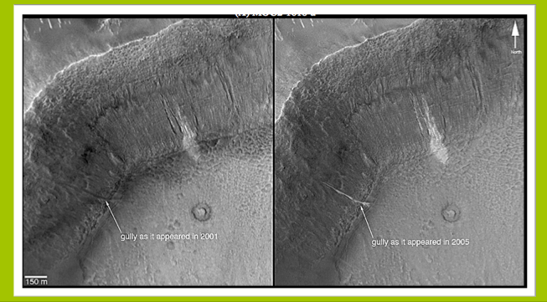
Surface Changes: Gullies!

Slide 14
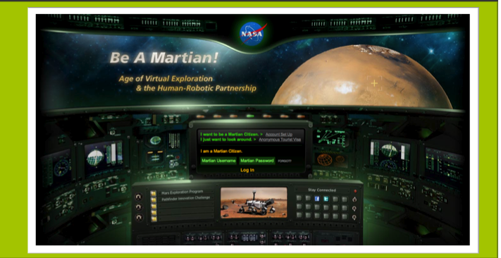
Be A Martian! In the Cloud!

Slide 15
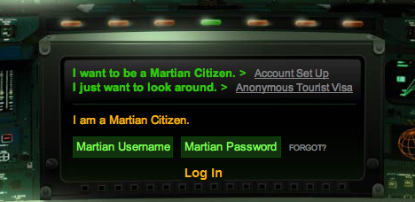
Establishing a Community

Slide 16

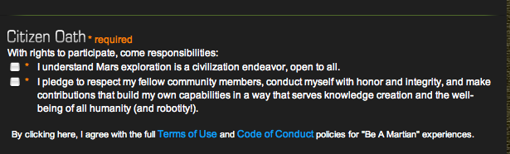

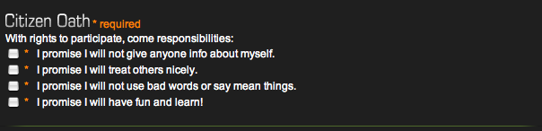
Community Codes

Slide 17
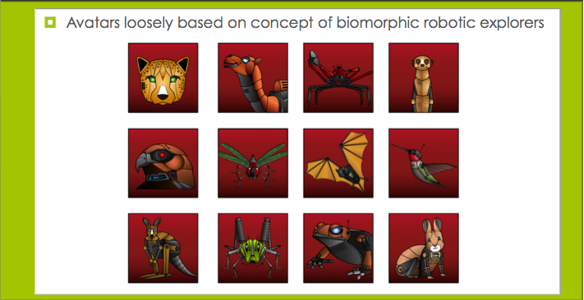
Citizen Identity Protected through Avatars
Made the decision not to collect data on participants, who are known only by their “citizen name”

Slide 18
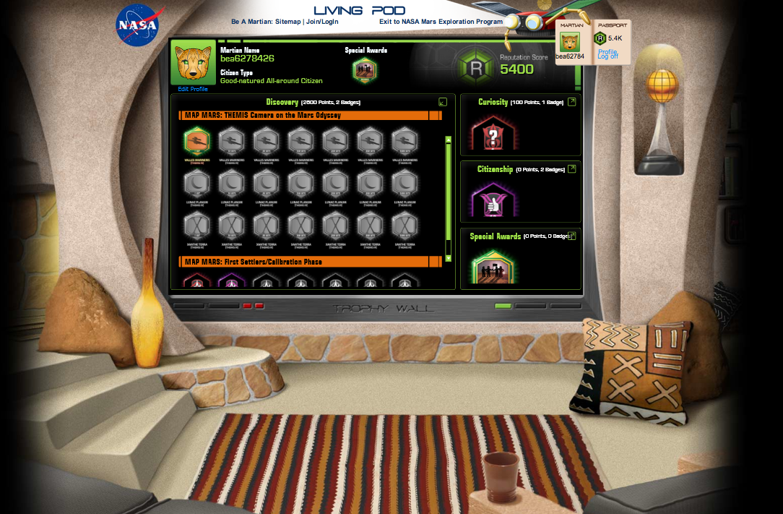
Citizens Gain Reputation with Knowledge
Through game-like reputation system, with knowledge may come greater privileges such as opportunities to work with the mission teams

Slide 19
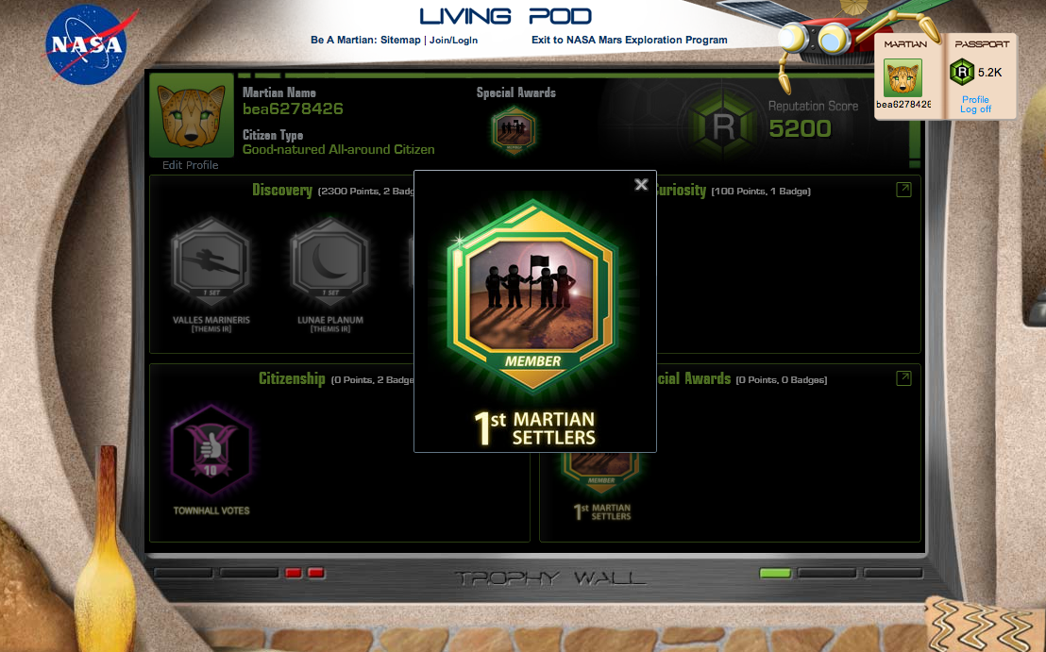
Show of Appreciation for 45,000+ Early Adopters

Slide 20
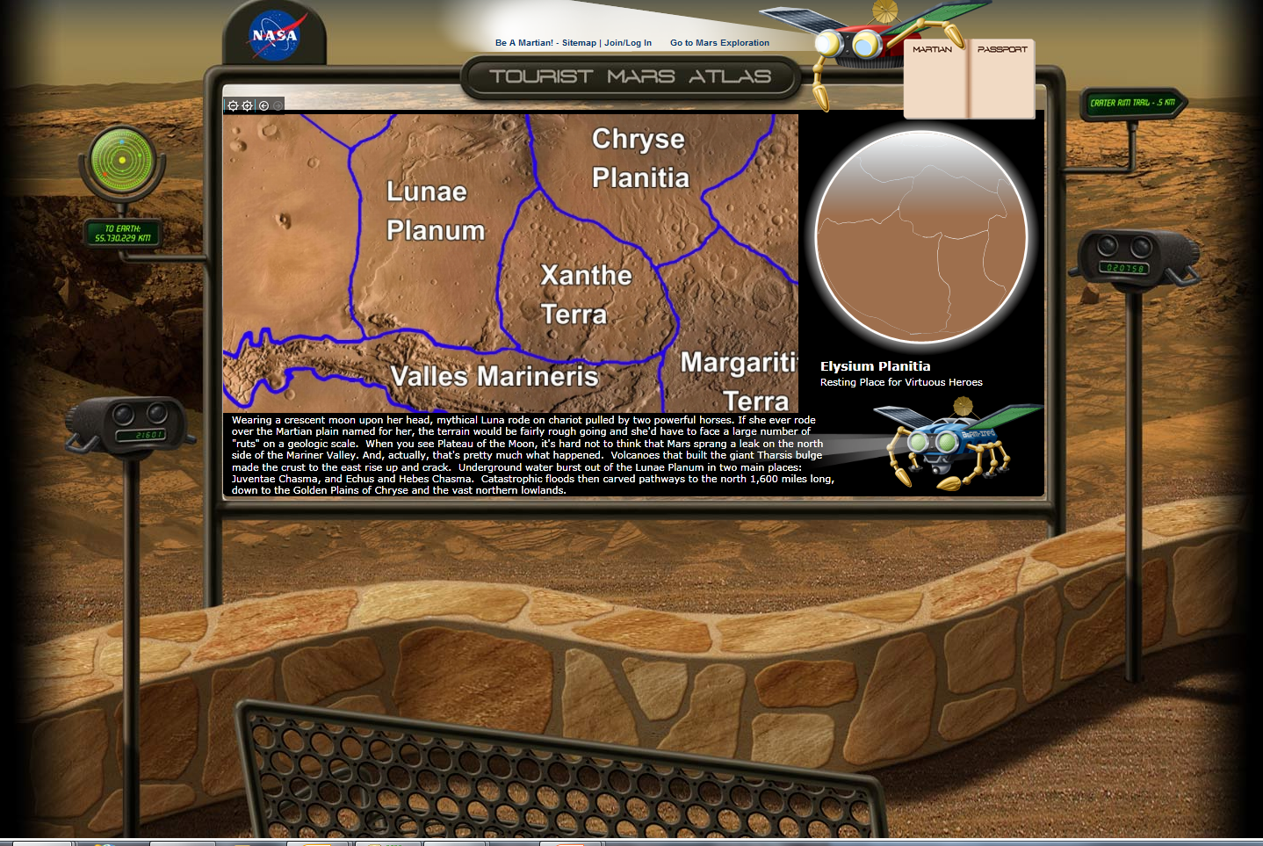
Citizens Access “Tourist Mars Atlas” for Intro
Citizens Have a Chance to Explore Mars Regions
Orientation is key—need to scaffold learning experience so it is not intimidating to new users

Slide 21
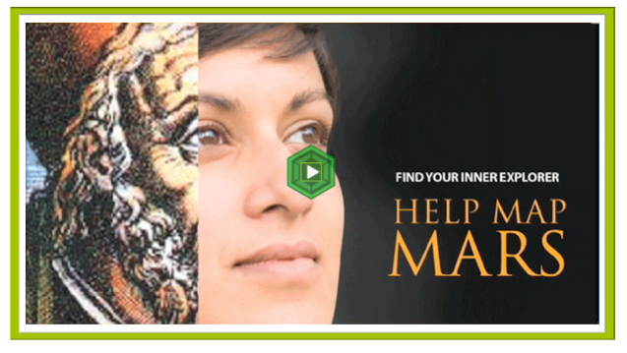
A Call to “Noble Purpose”
Establishing the authentic need and the narrative

Slide 22
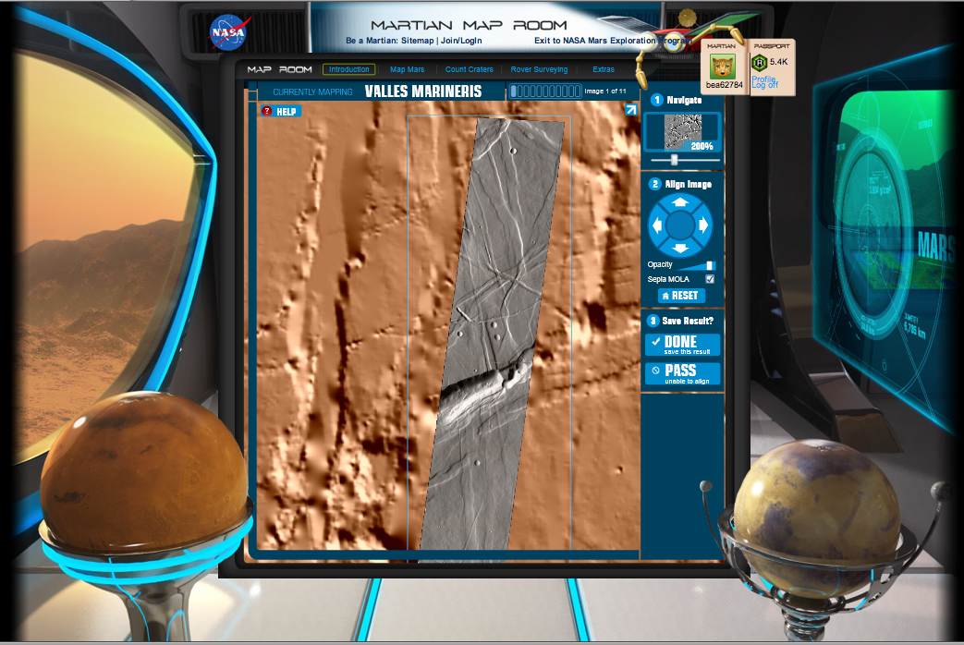
Citizens Help Map Mars
Registering data from multiple orbital missions

Slide 23
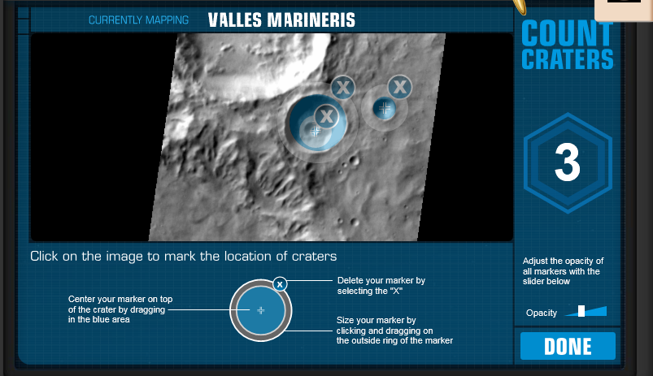
Citizens Help Count Craters
Assists with Age-dating Surface of Mars

Slide 24
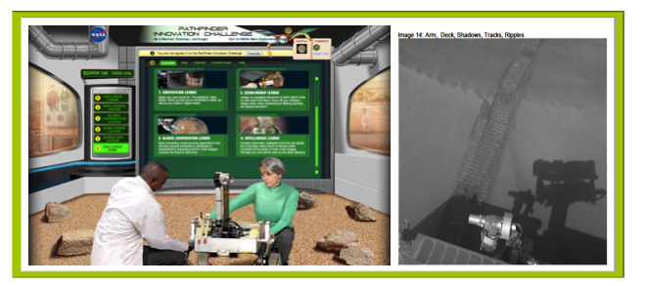
Citizens Contribute Digital Assets
Potential Result: More Crowd-sourcing Activities
  Truly “By the People, for the People”

Slide 25
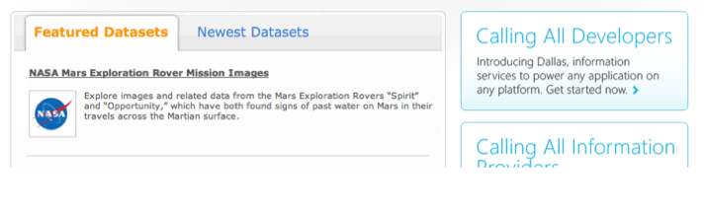
Making Datasets Easily Accessible
Leveraging free access to public data sets in catalogs/information services widely accessed by developers

Slide 26
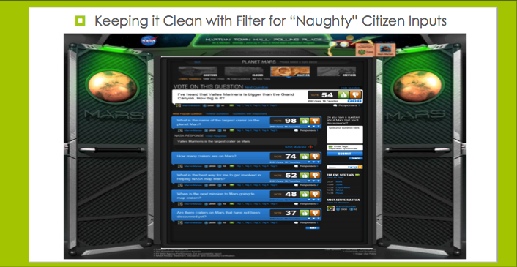
Citizens Weigh In with Questions & Votes

Slide 27
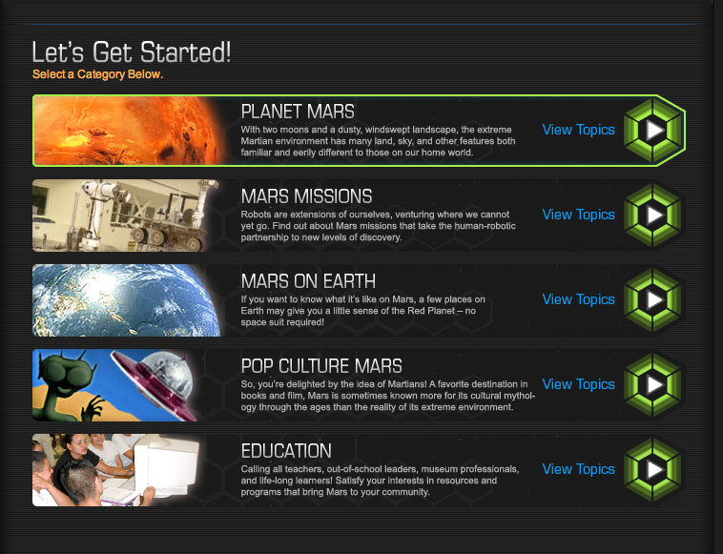
Question Categories
Guided approach to managing questions

Slide 28
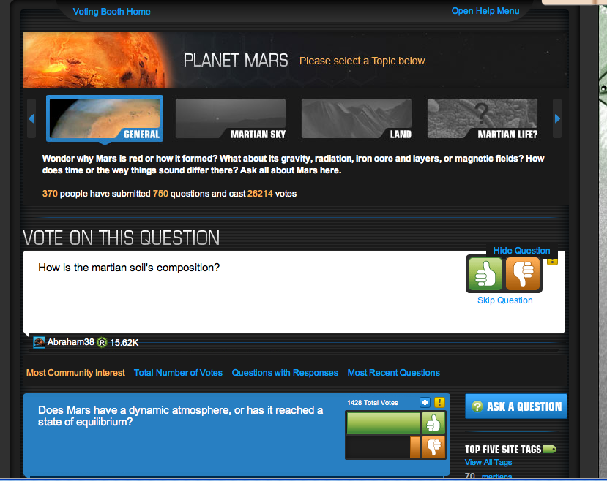
Questions & Voting
Given small staff, helps manage response time to citizens based on their priorities

Slide 29
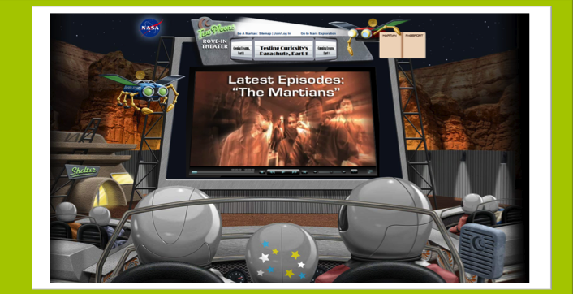
Citizens Served Video Series from Cloud
Experimenting with HD videos served from the cloud environment

Slide 30
Future Potential
More activities for students tied to education standards
  Working with data important digital-age skill
  Computer literacy opens up career opportunities
More diverse citizen science activities with expanded data sets, with more social networking
Near-real-time interactions with data returned by next rover to Mars named Curiosity, scheduled to land in 2012
  Mars landings are “Olympic-sized Internet Events,” so capacity to scale up for world-wide interest and access will be key to “data on demand”

Slide 31

Questions?

